Slide 1

AIRBNB MARKET STUDY
Punta Cana Airbnb Pricing Analysis
PROJECT 1·DAVID J. GIBBENS·APRIL 19, 2026 · www.linkedin.com/in/djogibbens
Notes:
Slide 1: Hola, les habla David Gibbens y el dia de hoy, les hablare de mi primer Proyecto: Punta Cana Airbnb Pricing Analysis. This project explores which listing characteristics drive nightly rental prices in one of the Caribbean's most popular tourism destinations.

Slide 2

INTRODUCTION
Introduction & Research Question
Punta Cana is a major tourism destination in the Dominican Republic
Understanding price drivers helps hosts optimize pricing and guests understand cost
Project follows a structured 8-step analytical process
RESEARCH QUESTION
Which listing characteristics best explain variation in nightly Airbnb prices in Punta Cana?
Punta Cana, Dominican Republic
Notes:
Slide 2: Punta Cana is a major tourism hub in the Dominican Republic, attracting millions of visitors each year. Understanding what drives Airbnb pricing there can help hosts optimize their rates and help guests understand what they're paying for. My research question is: Which listing characteristics best explain variation in nightly Airbnb prices in Punta Cana? To answer that, I followed an eight-step process — from loading and cleaning the data, through exploratory analysis, to fitting and interpreting a multiple regression model.

Slide 3

Dataset Description
195
RAW LISTINGS
63
ORIGINAL VARIABLES
4
KEY VARIABLES USED
KEY VARIABLES SELECTED FOR ANALYSIS
price
TTM avg nightly rate
guests
max capacity
bedrooms
count
baths
count
Data from AirRoi.com, exported April 4, 2026
Notes:
Slide 3: The dataset comes from AirRoi.com, exported on April 4th, 2026. It contains 195 Airbnb listings in Punta Cana across 63 variables. For this analysis, I focused on four key variables: price — which is the trailing twelve-month average nightly rate — along with guests, bedrooms, and bathrooms. These are numeric, interpretable, and directly tied to property size and capacity.

Slide 4
Data Cleaning & Wrangling
Preparing the raw Airbnb dataset for regression analysis
1
2
3
4
REMOVE
FILTER
CONVERT
RESULT
Removed listings with missing or zero prices
Removed listings missing guests, bedrooms, or baths
All predictors converted to numeric type
Final clean dataset: 190 listings
Ensures a clean, complete dataset suitable for regression modeling — only 5 of 195 raw listings were excluded.
Notes:
Slide 4: Before modeling, I cleaned the data in four steps. I removed listings with missing or zero prices, then dropped any rows missing values for guests, bedrooms, or bathrooms. All predictor variables were converted to numeric format. After cleaning, I was left with 190 complete listings — a clean, reliable dataset ready for analysis.

Slide 5
EXPLORATORY DATA ANALYSIS
Summary Statistics for Nightly Rate
MINIMUM
$18.30
Lowest nightly rate
Q1 (25TH %ILE)
$63.20
Lower quartile
MEDIAN
$99.25
Center of distribution
MEAN
$177.45
Pulled right by luxury listings
Q3 (75TH %ILE)
$164.88
Upper quartile
MAXIMUM
$2,738.10
Highest nightly rate
Distribution is right-skewed — most listings cluster in the lower-to-mid range with a long tail of luxury properties. The mean ($177) is nearly 1.8× the median ($99), confirming skewness. Wide variation justifies using regression to explain price differences.
Notes:
Slide 5: Here's a snapshot of the nightly rate distribution. The minimum price is just $18.30, while the maximum reaches $2,738 — a massive range. The median sits at $99.25, but the mean is $177.45, which tells us the distribution is right-skewed. Most listings cluster in the lower-to-mid price range, with a smaller number of luxury properties pulling the average up. This wide variation is exactly why regression analysis is useful here — there's real price variation to explain.

Slide 6
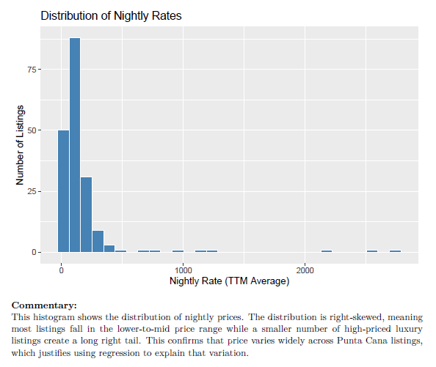

Distribution of Nightly Rates
TTM Average Nightly Rate across Punta Cana Airbnb Listings
Distribution of Nightly Rates (TTM Average)
KEY DISTRIBUTION STATS
$99
$177
Right-skewed
Median Rate
Mean Rate
$18
$2,738
Minimum
Maximum
Mean > Median confirms right skew
INTERPRETATION
The distribution is right-skewed — most listings fall in the lower-to-mid price range while a smaller number of high-priced luxury listings create a long right tail. This confirms price varies widely across Punta Cana listings.
Notes:
Slide 6: This histogram visualizes that skewness. You can see the bulk of listings concentrated on the left side — under $200 per night — with a long tail stretching to the right for high-end properties. This confirms what the summary statistics told us: most Punta Cana Airbnbs are affordable, but a handful of luxury listings push the distribution rightward.

Slide 7

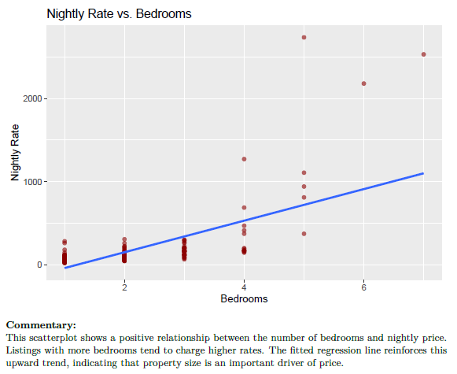
Nightly Rate vs. Bedrooms
Exploratory Visualization — Scatterplot Analysis
INTERPRETATION
Positive relationship — listings with more bedrooms tend to charge higher nightly rates. The fitted regression line reinforces this upward trend, indicating property size is an important driver of price.
CORRELATION
r = 0.639
price–bedrooms
Notes:
Slide 7: Now let's look at the relationship between price and bedrooms. Each point represents a listing, and the fitted regression line shows a clear positive trend — listings with more bedrooms tend to charge higher nightly rates. This makes intuitive sense. More bedrooms generally mean a larger property, which commands a higher price. You'll also notice some spread at the higher bedroom counts, reflecting variation in property quality and amenities.

Slide 8
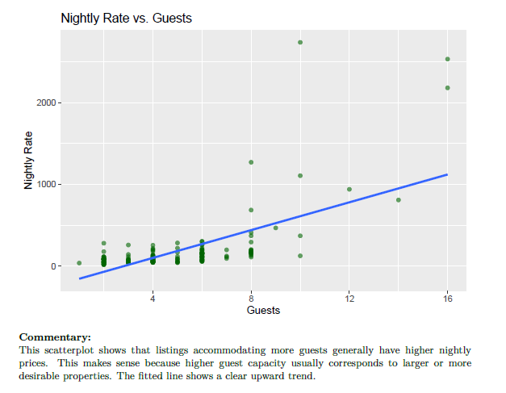
EXPLORATORY DATA ANALYSIS
Price vs. Guests
SCATTERPLOT
Key Insight
Listings accommodating more guests generally have higher nightly prices. The fitted line shows a clear upward trend.
Why This Matters
Higher guest capacity usually corresponds to larger or more desirable properties.
Guest capacity is a key predictor of nightly rate, with correlation r = 0.639.
Variance increases at higher guest counts — luxury outliers widen the spread.
Notes:
Slide 8: Here we see price plotted against guest capacity. Again, there's a positive relationship — listings that accommodate more guests tend to have higher nightly rates. Higher guest capacity usually means a larger or more desirable property, so this upward trend aligns with expectations. The fitted line reinforces that as capacity increases, price tends to follow.

Slide 9

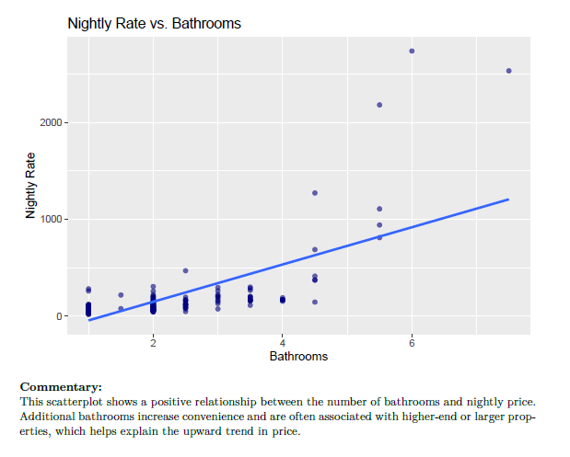
EXPLORATORY DATA ANALYSIS
Nightly Rate vs. Bathrooms
Key Insight
POSITIVE RELATIONSHIP
Additional bathrooms increase convenience and are often associated with higher-end or larger properties, helping explain the upward trend in price.
CORRELATION
r = 0.677
DIRECTION
Upward trend confirmed
Strongest single predictor of nightly price among the three numeric variables in the model.
Notes:
Slide 9: The third scatterplot shows price against the number of bathrooms. This also shows a positive trend, and among our three predictors, bathrooms actually has the strongest individual correlation with price at 0.677. Additional bathrooms signal convenience and are typically found in higher-end or larger properties, which helps explain why this variable is such a strong predictor.

Slide 10
STEP 6 · VARIABLE SELECTION
Correlation Analysis & Variable Selection
Correlation Matrix
Key Takeaways
PRICE
GUESTS
BEDROOMS
BATHS
All three predictors show positive correlations with price (~0.64–0.68)
PRICE
1.000
0.639
0.639
0.677
GUESTS
0.639
1.000
0.928
0.877
BEDROOMS
0.639
0.928
1.000
0.933
Selected because they are numeric, interpretable, and logically related to property size
BATHS
0.677
0.877
0.933
1.000
Price correlation (0.64–0.68)
High inter-predictor (0.88–0.93)
High inter-predictor correlations (0.88–0.93) foreshadow multicollinearity
Correlation with Price
Baths
0.677
Guests
0.639
Bedrooms
0.639
While all three variables are good price predictors individually, their strong overlap with each other will make it difficult to isolate each predictor's unique contribution in a regression model.
Notes:
Slide 10: Before building the model, I examined the correlation matrix. All three predictors — guests, bedrooms, and bathrooms — show positive correlations with price, ranging from about 0.64 to 0.68. However, notice the inter-predictor correlations. Guests and bedrooms correlate at 0.928. Bedrooms and bathrooms at 0.933. These are very high — they all measure aspects of property size, and they move together. This foreshadows an issue we'll see in the regression output: multicollinearity. I selected these three predictors because they're numeric, interpretable, and directly tied to property capacity — but their overlap will affect how we read the coefficients.

Slide 11



REGRESSION RESULTS
Multiple Regression Model & R²
price ~ guests + bedrooms + baths
PREDICTOR
COEFFICIENT
P-VALUE
SIG.
Intercept
−255.52
< 0.001
***
MODEL FIT
0.4699
Guests
+38.09
0.047
*
Bedrooms
−56.93
0.322
n.s.
R-SQUARED
47% of price variation explained
Baths
+171.72
< 0.001
***
0.4614
54.97
< 2.2e⁻¹⁶
*** p < 0.001
* p < 0.05
n.s. not significant
ADJ. R²
F-STATISTIC
P-VALUE
47%
Explained by model 53% unexplained
For a simple model using only three numeric predictors, this is a strong result — nearly half of all price variation is captured.
Notes:
Slide 11: Here's the regression output. The model is price predicted by guests, bedrooms, and bathrooms. Looking at the coefficients: the intercept is negative 255.52, guests has a coefficient of 38.09 and is significant, bedrooms is negative 56.93 but not statistically significant, and bathrooms is 171.72 and highly significant. The R-squared is 0.4699, meaning this model explains about 47% of the variation in nightly price. The adjusted R-squared is 0.4614, and the overall F-statistic is 54.97 with a p-value well below 0.001. For a simple model using just three numeric predictors, explaining nearly half the price variation is a strong result.

Slide 12
REGRESSION INTERPRETATION
Regression Equation & Multicollinearity
price = −255.52 + 38.09(guests) − 56.93(bedrooms) + 171.72(baths)
Why is bedrooms negative?
guests
bedrooms
Guests and bedrooms both measure property size — they move together
High inter-predictor correlation means the model struggles to separate individual effects
r = .93
OVERLAP
This overlap is called multicollinearity
The negative coefficient is a statistical artifact, not a real-world effect
When predictors share 93% correlation, the model can't cleanly attribute effects to either one alone.
Bottom line: Larger, higher-capacity properties tend to have higher nightly rates.
Notes:
Slide 12: The full regression equation is: price equals negative 255.52, plus 38.09 times guests, minus 56.93 times bedrooms, plus 171.72 times bathrooms. Now — the natural question is: why is bedrooms negative? More bedrooms should mean higher prices, right? And individually, it does. But in the model, guests and bedrooms are so highly correlated — 0.928 — that the model can't cleanly separate their individual effects. This is called multicollinearity. The negative coefficient on bedrooms isn't a real-world effect — it's caused by overlapping predictors. Each variable is trying to explain the same underlying concept: nightly rates. More advanced diagnostics like VIF exist but are outside the scope of this 300-level course. Using course-covered tools — scatterplots, the correlation matrix, and the regression summary — we can still identify and explain this issue clearly.

Slide 13
Key Findings, Limitations & Conclusion
KEY FINDINGS
LIMITATIONS
1
Listings with more guests, bedrooms, and bathrooms tend to have higher nightly rates.
Observational data — no causal claims can be made.
Only numeric predictors used — categorical variables like property type and amenities could improve the model.
Multicollinearity limits individual coefficient interpretation.
2
A three-predictor model explains ~47% of price variation (R² ≈ 0.47).
MODEL PERFORMANCE
R² = 0.47
47% of nightly rate variation explained
3
The negative bedrooms coefficient is due to overlapping predictors, not a real effect.
MODEL
price ~ guests + bedrooms + baths
Thank You — Questions?
David J. Gibbens
Notes:
Slide 13: To wrap up — three key findings. First, listings with more guests, bedrooms, and bathrooms consistently have higher nightly rates. Second, the three-predictor model explains about 47% of price variation, which is meaningful for observational data. And third, the negative bedrooms coefficient is due to multicollinearity, not a real-world effect. There are limitations. This is observational data, so we can't establish causation. The dataset is limited to 190 listings in one market. And we only used three numeric predictors — factors like location, reviews, amenities, and property type could improve the model. In conclusion, property size and capacity are meaningful drivers of Airbnb pricing in Punta Cana, but a more complete model would benefit from additional variables. Gracias y que tengas un buen dia..

